Slide 1
NOTTS - AI Monthly Catch-up - June 2019
Ethics Guidelines for Trustworthy AI
While we wait...are you on slack yet?
Yes, then good :)
No, here is a cryptic invite
- Head to https://notts.ai/
- Bottom right corner (footer)
- Find the invite

Slide 2
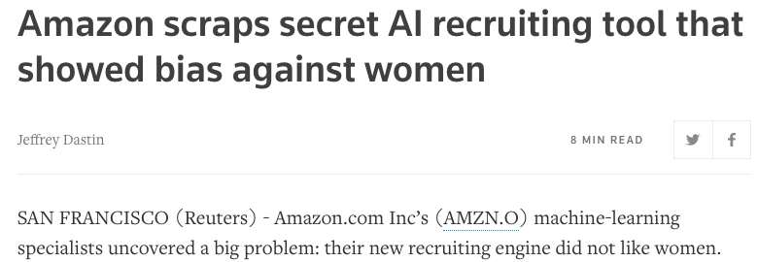
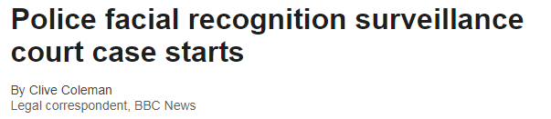
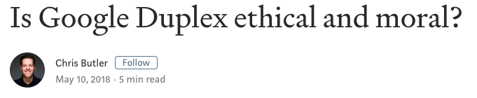
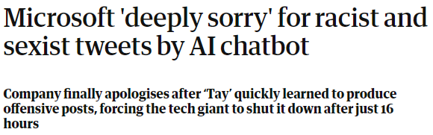
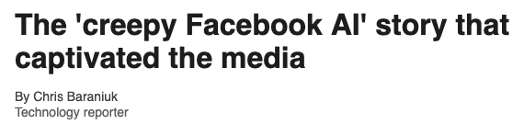
"Why Should I Trust You?"

Slide 3
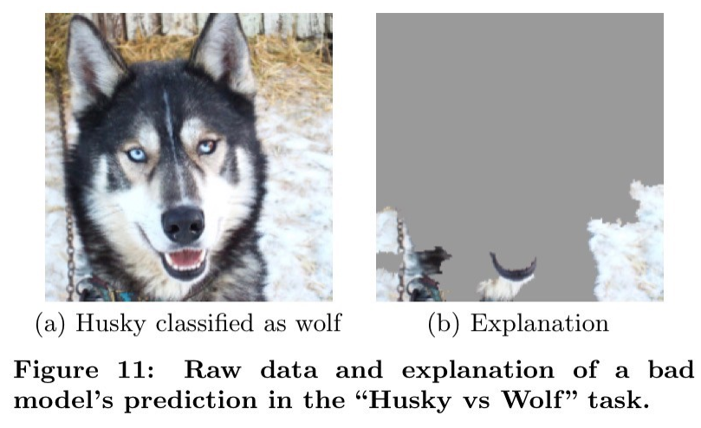
“Its Magic….. I Owe no explanation"
Bias can occur when,
why it’s so hard to fix bias
Framing the problem.
Collecting the data.
Preparing the data.
Unknown unknowns.
Imperfect processes.
Lack of social context.
The definitions of fairness.

Slide 4
AI HLEG
Vision
Needs to be
Increasing public and private investments in AI to boost its uptake,
Preparing for socio-economic changes, and
Ensuring an appropriate ethical and legal framework to strengthen European values.
human-centric.
maximise the benefits of AI systems.
preventing and minimising their risks.
Trustworthy AI as foundational ambition.
Components
Lawful
Ethical
Robust
More information on the High-Level Expert Group on Artificial Intelligence is available online (https://ec.europa.eu/digital-single-market/en/high-level-expert-group-artificial-intelligence).

Slide 5
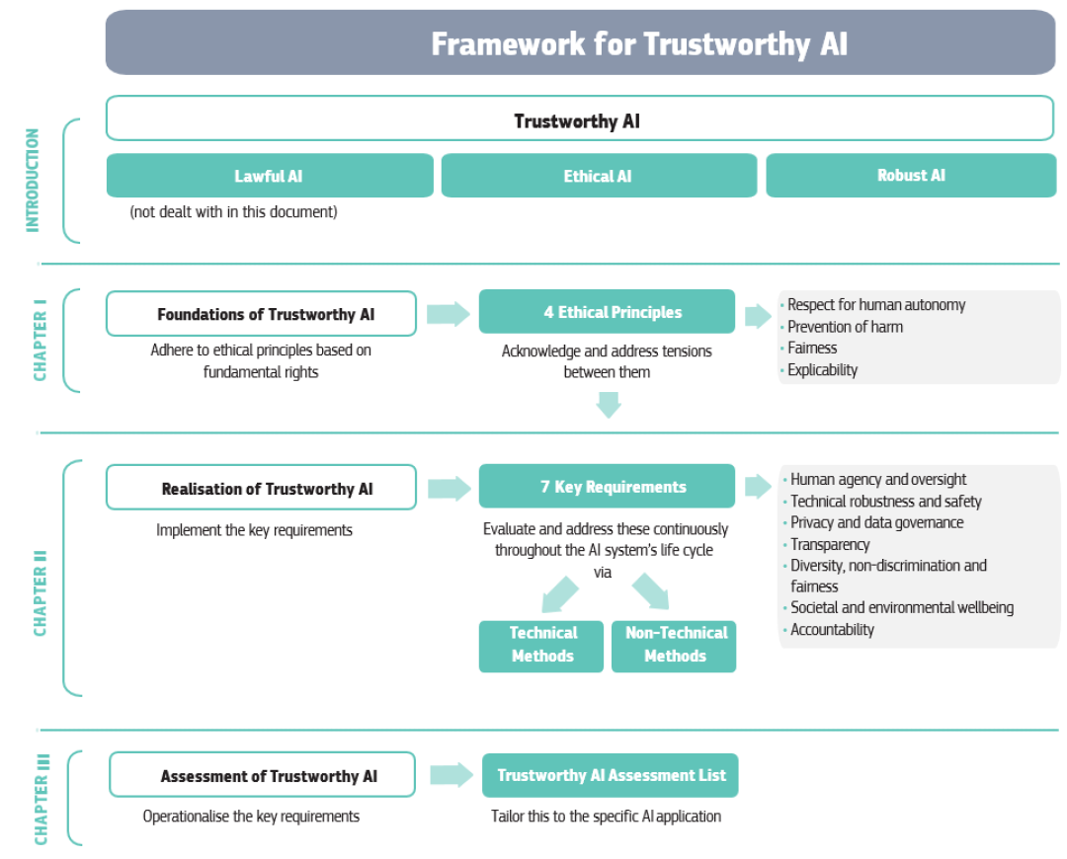
Guidelines as a Framework

Slide 6
Foundations of Trustworthy AI
The principle of respect for human autonomy
Humans interacting with AI systems must be able to keep full and effective self-determination over themselves, and be able to partake in the democratic process. AI systems should not unjustifiably subordinate, coerce, deceive, manipulate, condition or herd humans
The principle of prevention of harm
AI systems should neither cause nor exacerbate harm. They must be technically robust and it should be ensured that they are not open to malicious use.
The principle of explicability
An explanation as to why a model has generated a particular output or decision. Cases where this is not possible (‘Black Box’) need special attention. Traceability, auditability and transparent communication on system capabilities required.
The principle of fairness
ensuring equal and just distribution of both benefits and costs, and ensuring that individuals and groups are free from unfair bias, discrimination and stigmatisation.

Slide 7
Requirements of Trustworthy AI
human-in-the-loop (HITL).
human-on-the-loop (HOTL).
human-in-command (HIC) approach.
Auditability.
Minimisation and reporting of negative impacts.
Trade-offs.
Redress.
Resilience to attack and security.
Fallback plan and general safety.
Accuracy.
Reliability and Reproducibility.
Data Protection.
Quality and integrity of data.
Access to data.
Sustainable and
environmentally friendly AI.
Social impact.
Society and Democracy.
Traceability.
Explainability.
Communication.
Avoidance of unfair bias.
Accessibility and universal design.
Stakeholder Participation.

Slide 8
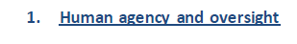
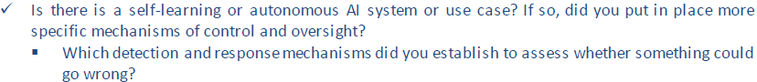
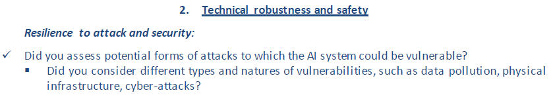
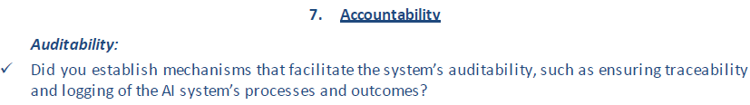
Assessing Trustworthy AI

Slide 9

Register for the Piloting Process
https://ec.europa.eu/futurium/en/ethics-guidelines-trustworthy-ai/register-piloting-process-0
Feedback will be gathered through an online survey, which will be launched in June 2019.
Based on this feedback, the High-Level Expert Group on AI (AI HLEG) will propose a revised version of the assessment list to the Commission in early 2020.

Slide 10
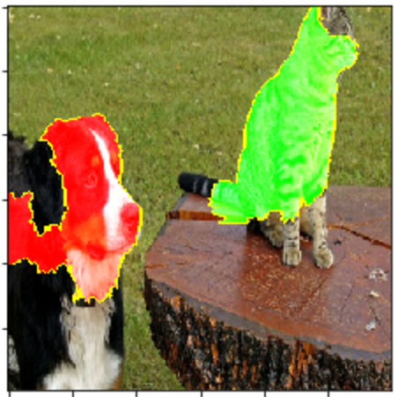
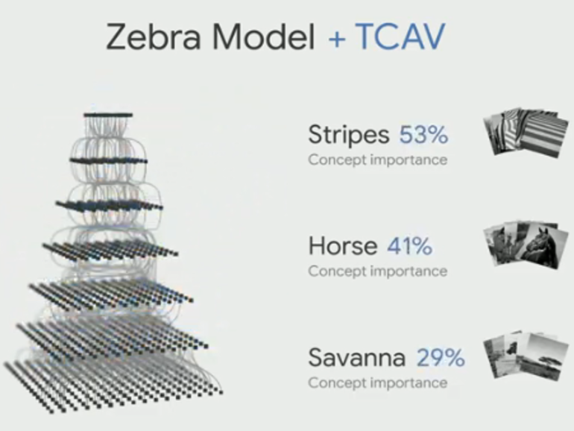
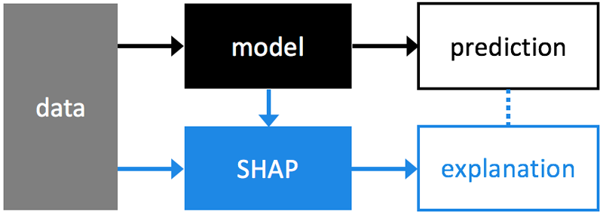
What tools can help me out
IBM’s AI Fairness 360 (Open Source)
A comprehensive set of fairness metrics for datasets and machine learning models, explanations for these metrics, and algorithms to mitigate bias in datasets and models
http://aif360.mybluemix.net/
LIME (Open Source)
Explaining the predictions of any machine learning classifier
https://www.youtube.com/watch?v=hUnRCxnydCc
https://github.com/marcotcr/lime
SHAP (Open Source)
A unified approach to explain the output of any machine learning model.
https://github.com/slundberg/shap
Google’s TCAV
Testing with Concept Activation Vectors (TCAV) is a new interpretability method to understand what signals your neural networks models uses for prediction.
https://github.com/tensorflow/tcav

Slide 11
Monthly Challenge (June 2019) – Data Visualisation
Idea: ‘World Cloud’ displaying interests of all the members.
Details: Read Meetup profile data. Lookup Interests. Generate a word cloud.
Dataset: Meetup profiles

Slide 12
Elsewhere on the Internet
Samsung AI Makes the Mona Lisa 'Speak’ https://www.youtube.com/watch?v=P2uZF-5F1wI
Adversarial patch to fool an AI system https://youtu.be/MIbFvK2S9g8
https://arxiv.org/abs/1904.08653

